Slide 1
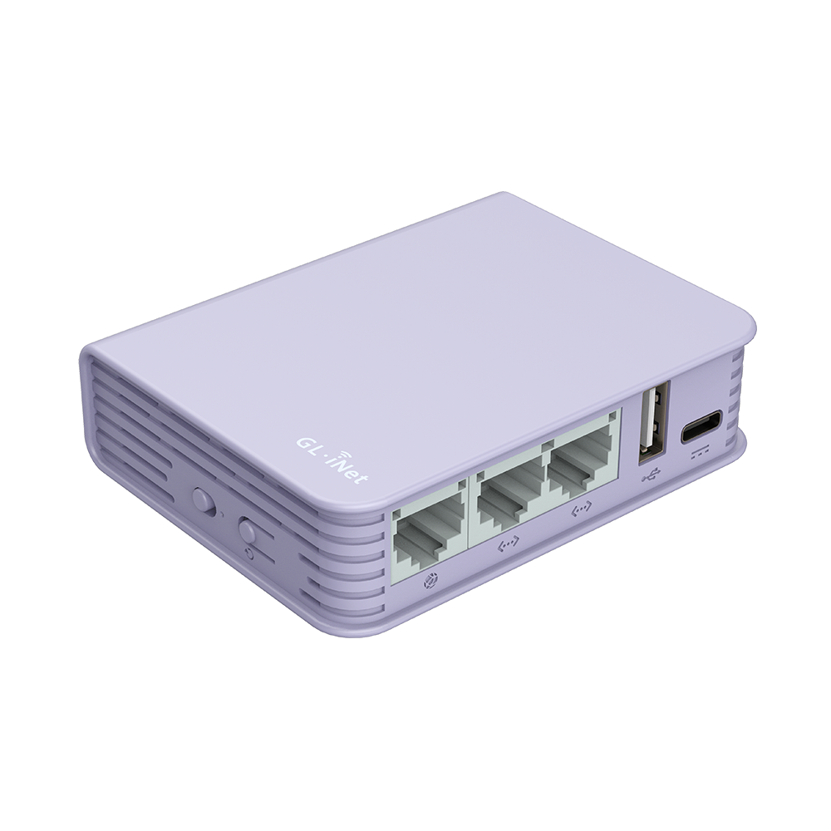
Ports
Interface which can communicate with other internal and external hardware components.

Slide 2
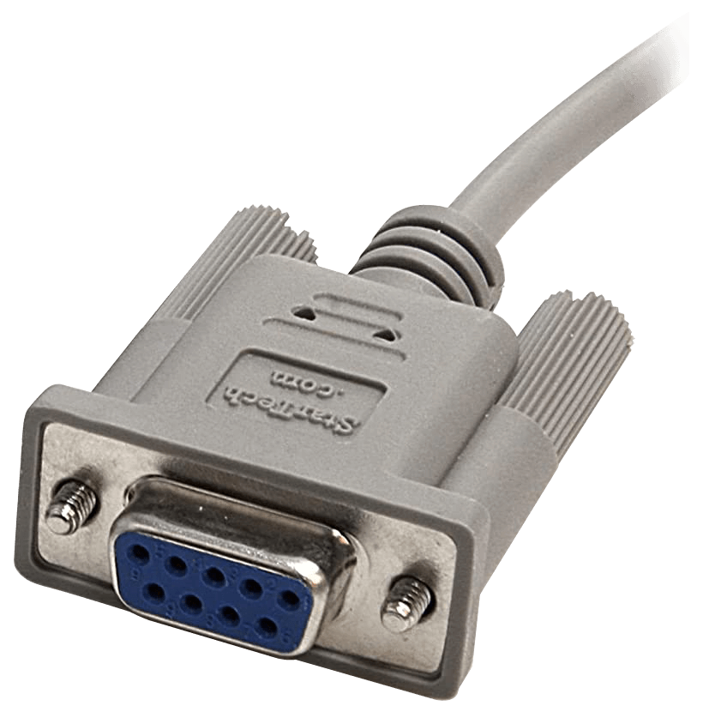
Serial Ports
Slower in speed as compared to parallel ports.
1
Sends data sequentially, One bit at a time over a single wire.
2
Contains at least 9 number of pins in minimum. For example VGA.
3

Slide 3
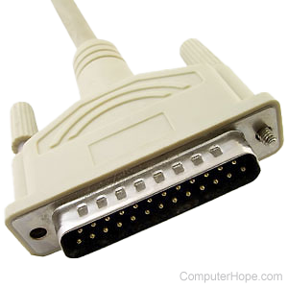
Parallel ports
Faster in speed as compared serial ports.
1
Transmits multiple bits of data simultaneously.
2
Mostly Used for printers and other devices.
3

Slide 4
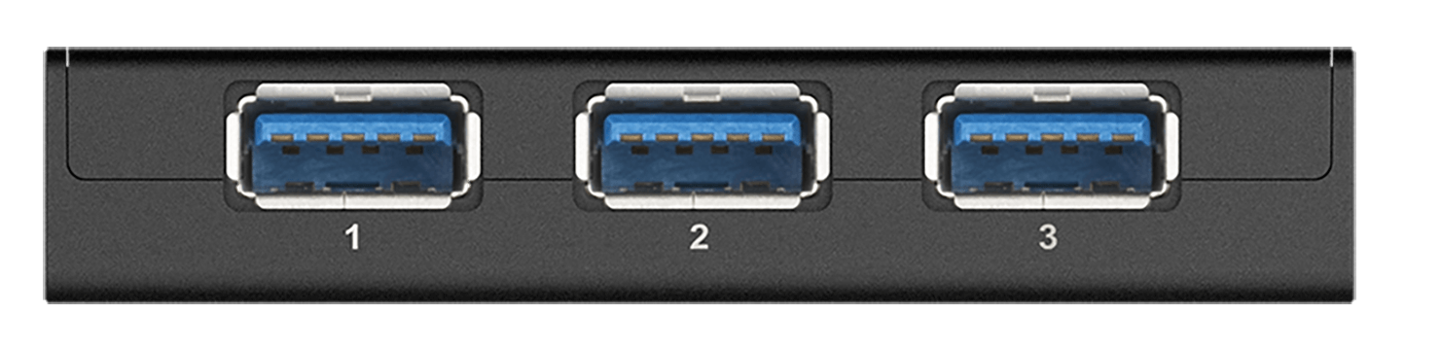
USB PORTS
Stands for Universal Serial Bus.
1
Mostly used for data transfer and charging purpose in different devices.
2
Can transfer up to 40 Gbps of data with video connectivity.
3

Slide 5
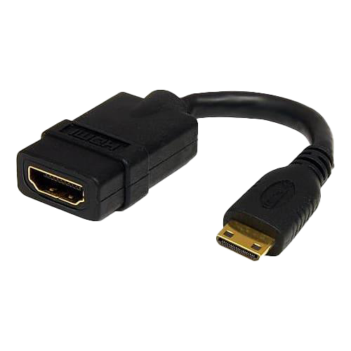
HDMI PORT
Stands for High Definition Multimedia Interface.
1
Allows transmission of both audio and video through single cable.
2
With compressing it can transfer upto 128 Gbps.
3

Slide 6
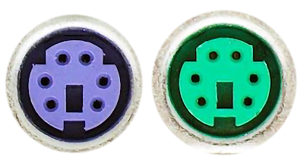
PS2 PORT
Stands for High Definition Multimedia Interface.
1
Contains 6 pins for data transfer and
2
Mostly Used for keyboard and mouse.
3

Slide 7
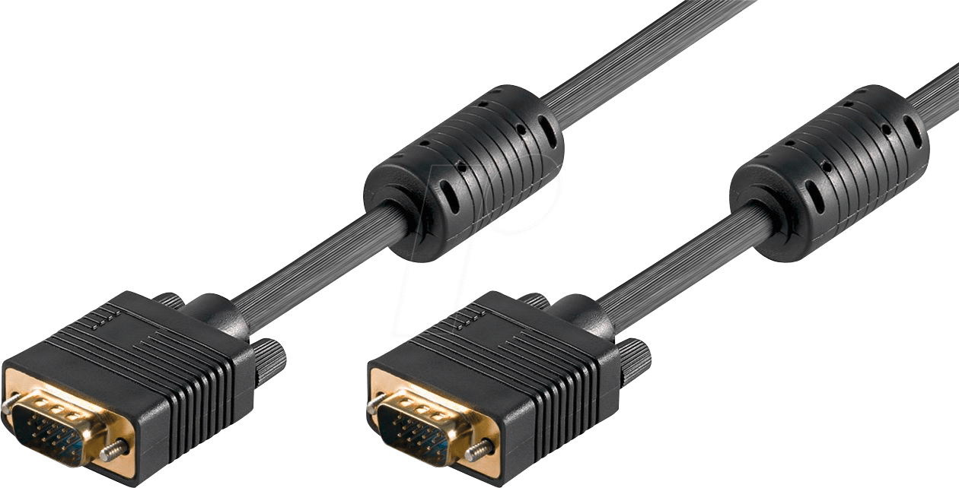
VGA Port
Stands for Video Graphics Array.
1
Contains 15 pins for data transfer.
2
Commonly used in monitors and display unit of a computer.
3

Slide 8
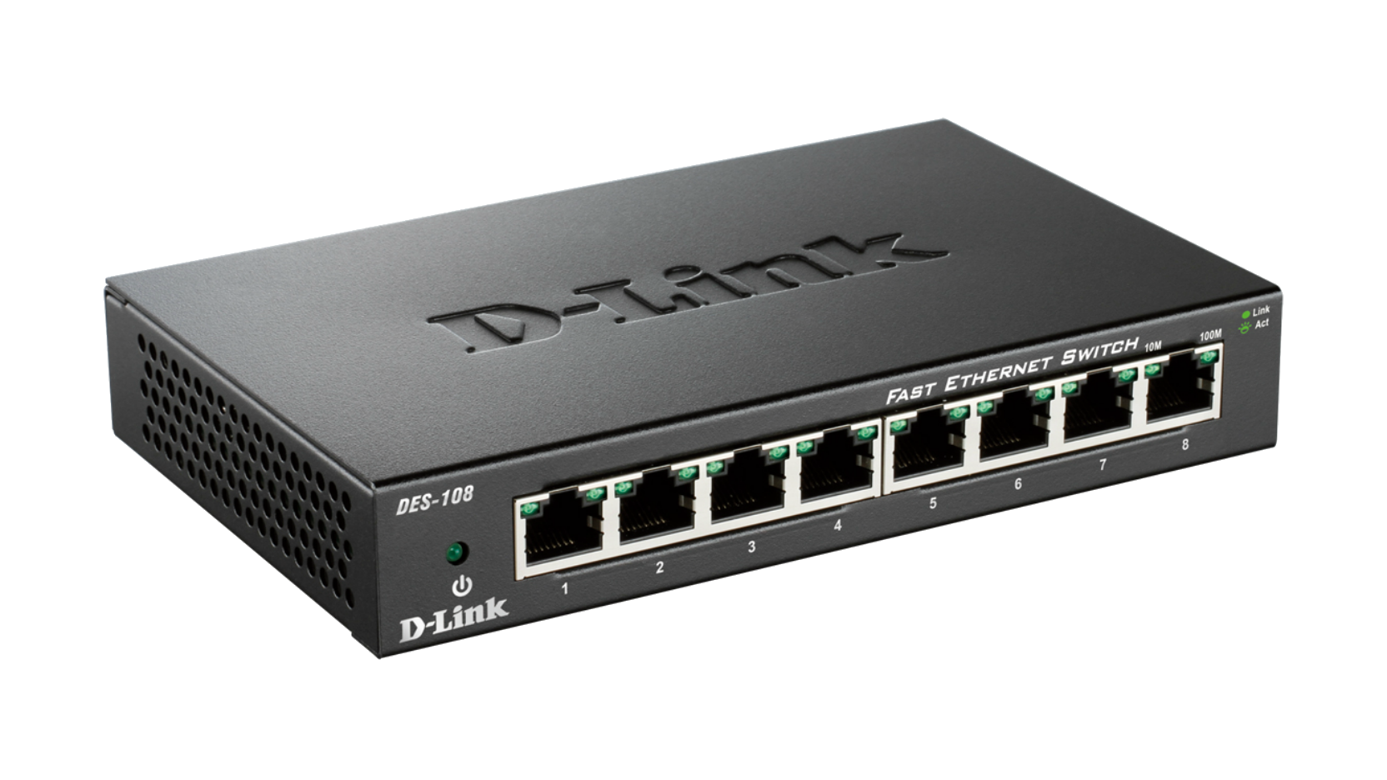
LAN port
Stands for Local Area Network
1
Contains 8 pins for data transfer.
2
Commonly used to connect computer with routers to access wifi.
3

